Slide 1
Towards 3D World Perspective View

Slide 2
Specifying the Viewing Volume
There are two ways of specifying a viewing volume.
Using a rectangular Parallelpiped, or box (Orthographic Projection)
Using a quadrangular pyramid (Perspective Projection)

Slide 3
Box-Shaped Viewing Volume

Slide 4
Specifying the Visible Range using Quadrangular (Perspective Projection)

Slide 8
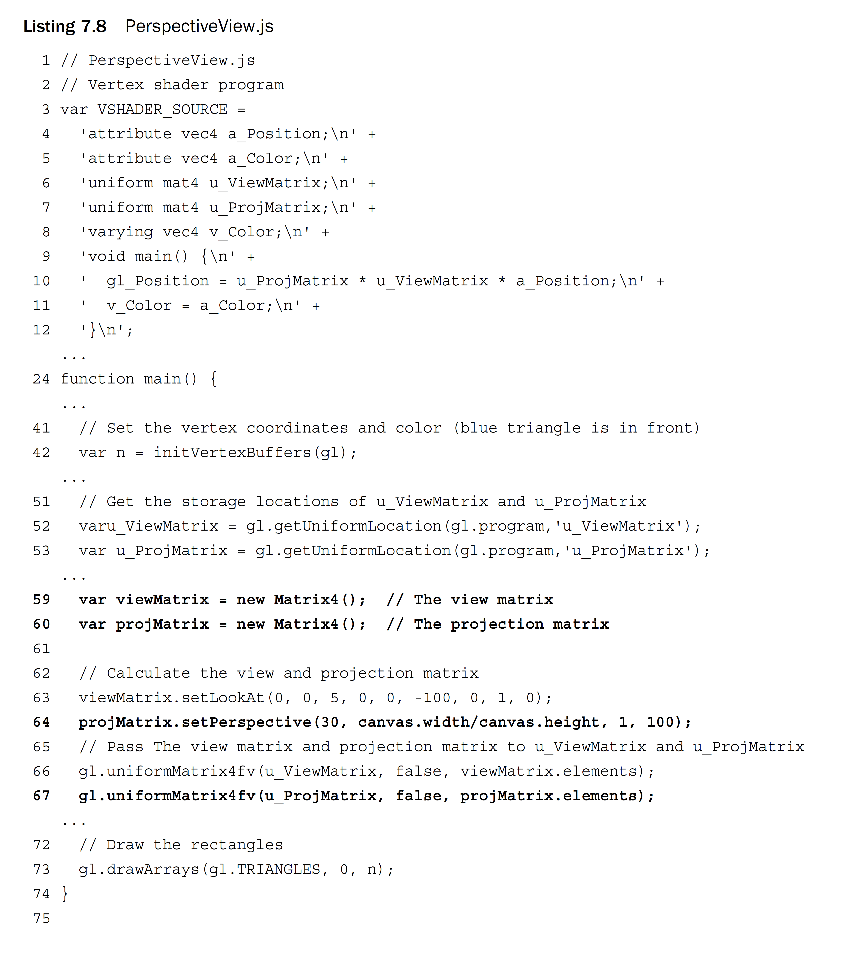

Slide 9
Transformation (Scaled Down and Shifted)

Slide 10
Using All Matrices (Drawing from Three Triangles)

Slide 11
Drawing from Three Triangles

Slide 13
